Slide 1



Four Ways to get Vapor Pressure
Short Cut Method
Approximation
Clausius-Clapyron
Equation
Use Peng-Robinson or other EOS and find where the fugacity ratio is 1
Antoine
Equation
Which method depends on accuracy needed, availability of parameters, and calculation speed required. For Clausius- Clapron Equation you can use
1) ecentricity, 2) critical point, 3) normal boiling point as reference points.
We want to know the vapor pressure to determine fractionation at vapor/liquid equilibria in Chapter 10 for multicomponent systems

Slide 2
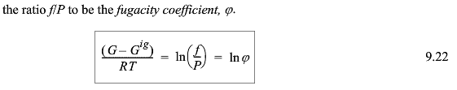



Gibb’s Free Energy decides phase equilibria at constant T and P
-SUV
H A
-pGT
dG=-SdT + VdP (depends on T and P)
G^{L} = G^{V} at equilibrium
dG = VdP (Constant T)

Slide 3
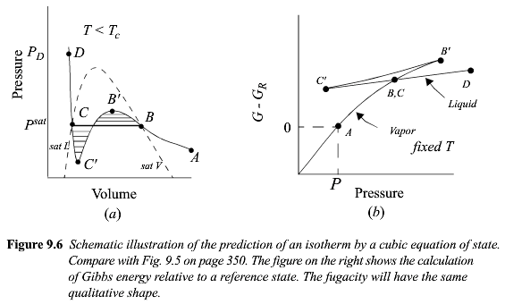
Vapor/Liquid Equilibria From EOS

Slide 4



-SUV
H A
-pGT

Slide 5
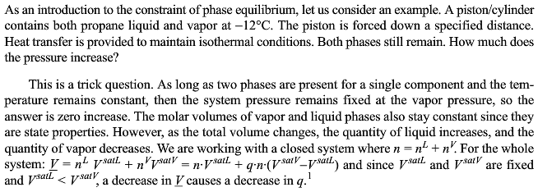



Slide 6
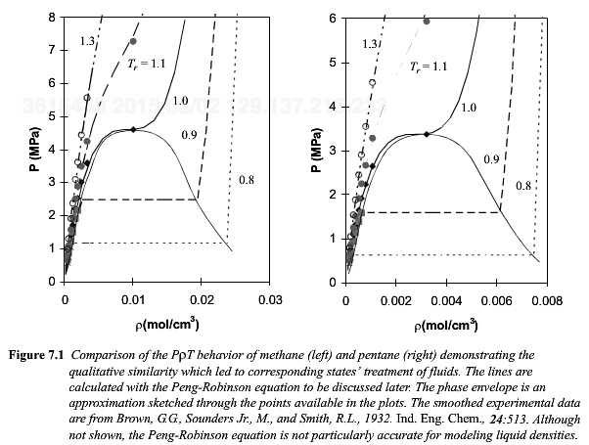

Slide 7
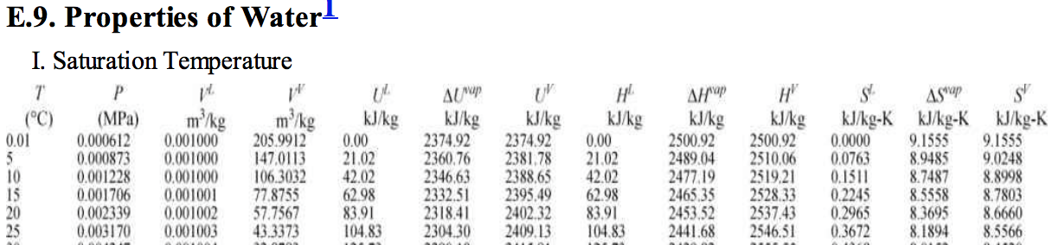
At 25°C pure liquid G = 105 kJ/kg – 298°K 0.367 kJ/kg°K = -4 kJ/kg
pure vapor G = 2547 kJ/kg – 298°K 8.56 kJ/kg°K = -4 kJ/kg
-SUV
H A
-pGT
G = H - TS

Slide 8
-SUV
H A
-pGT
dG = VdP – SdT
At V/L Equilibria
dG^{L} = dG^{V}
V^{V}dP^{sat} – S^{V}dT = V^{L}dP^{sat} – S^{L}dT
(V^{V}-V^{L}) dP^{sat} = (S^{V}-S^{L}) dT
Also
G = H - ST
At equilibrium ΔG^{vap} = 0
T^{vap} = ΔH^{vap} / ΔS^{vap}
From above
dP^{sat}/dT = ΔH^{vap}/(T(V^{V}-V^{L}))

Slide 9
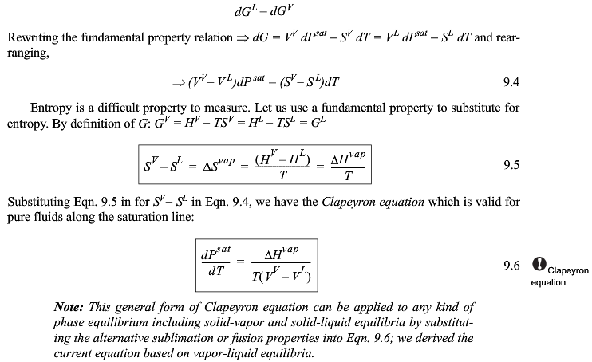

Slide 10
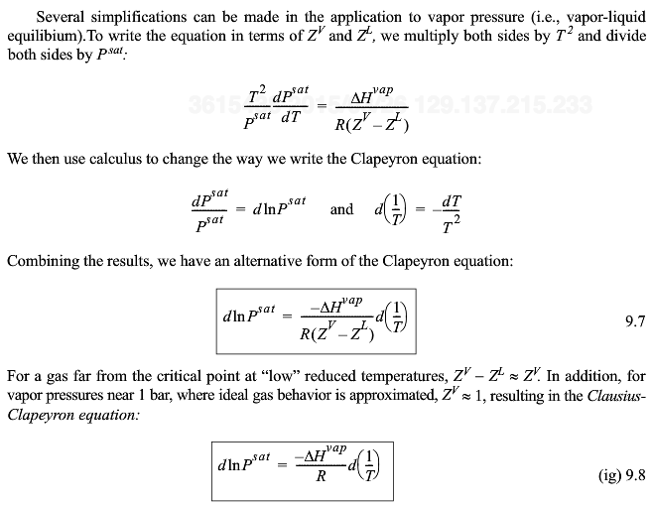
The slope of a plot of lnP_{sat} versus 1/T is -∆H_{vap}/R (for ideal gas approximation)

Slide 11
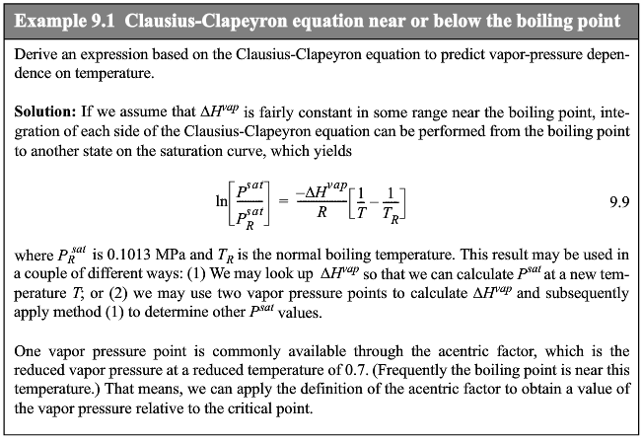

Slide 12



Slide 13


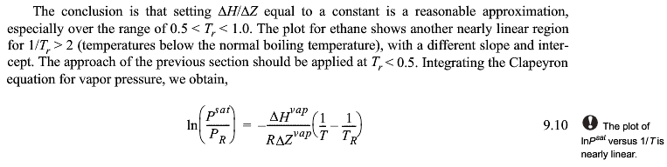
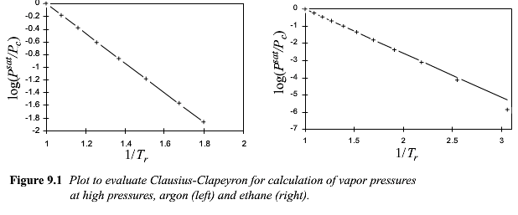

Slide 14

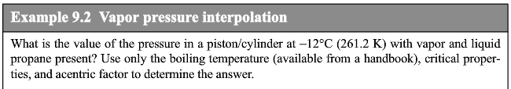
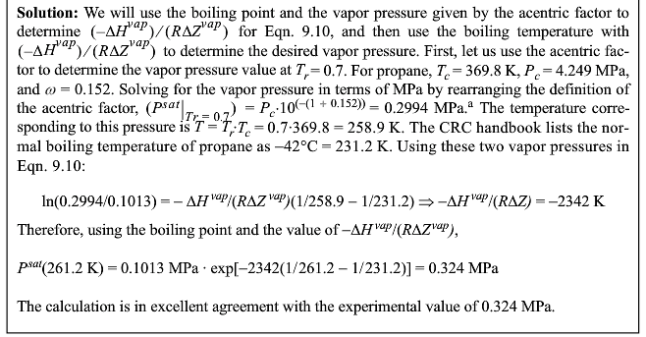

Slide 15
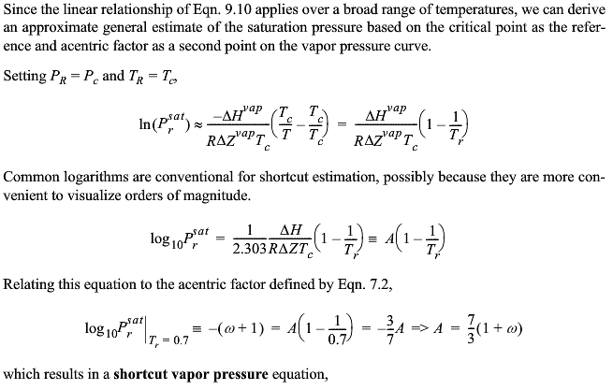
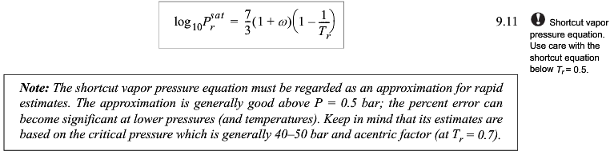

Slide 16

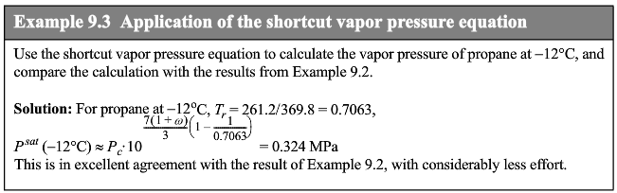

Slide 17
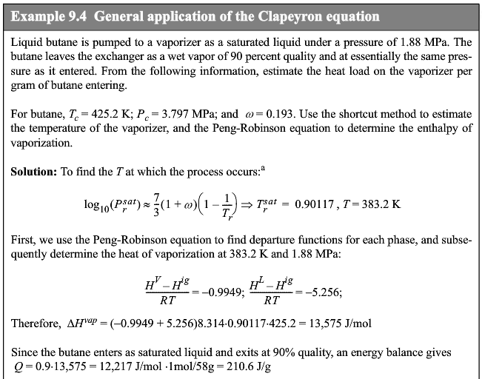

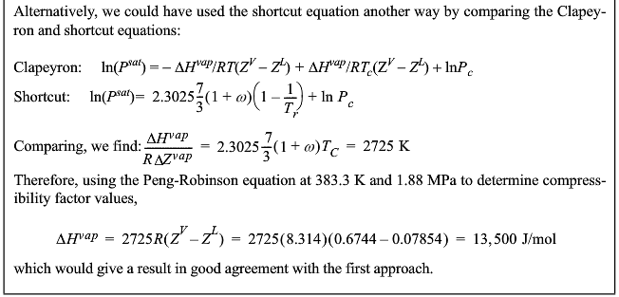

Slide 18
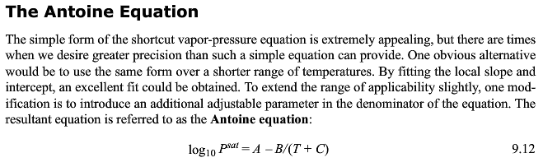

Slide 19
Four Ways to get Vapor Pressure
Short Cut Method
Approximation
Clausius-Clapyron
Equation
Use Peng-Robinson or other EOS and find where the fugacity ratio is 1
Antoine
Equation
Which method depends on accuracy needed, availability of parameters, and calculation speed required. For Clausius- Clapron Equation you can use
1) ecentricity, 2) critical point, 3) normal boiling point as reference points.

Slide 20


Slide 21
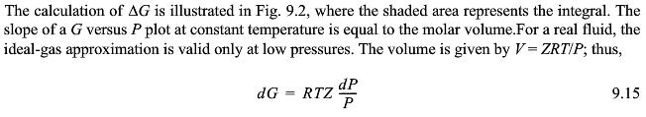
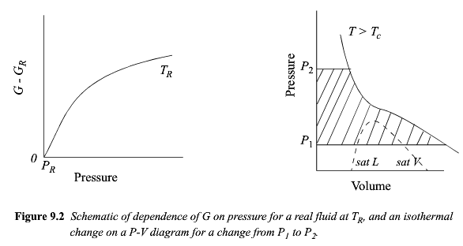


Slide 22


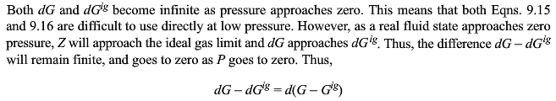

Slide 23
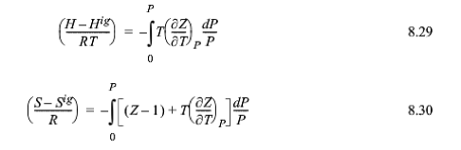
Pressure Dependent Formulas
-SUV
H A
-pGT
G = H - ST

Slide 24
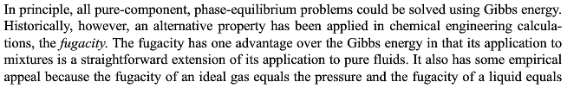


Slide 25
Arrhenius (1859-1927) Function:
Probability = exp(-ΔE/kT) or = exp(-ΔE/RT)
Gives the probability of an event happening if the event is thermally activated; i.e. if the probability changes with the temperature.
Viscosity = Viscosity₀ exp(- ΔE_{a}/kT) Flow happens when atoms thermally move out of the way with an activation energy ΔE_{a}
Vapor Pressure = P₀ exp(-ΔE_{vap}/kT) Antoine equation
ΔE_{vap} = ΔH_{vap} – T ΔS_{vap}
P_{sat} = P₀ exp(A – B/(T+C)) A = – ΔS_{vap}/R B = ΔH_{vap} C = Temp for no P_{sat}
Entropy prob. = exp(-S/R) Energy with no enthalpy (Boltzman equation)
Fugacity
f/P = exp((G-G^{ig})/RT) = probability of a molecule escaping from a phase
G = H - TS is a measure of the balance between enthalpic attractions and thermally driven dispersion of the molecules. So f is a measure of the dispersibility of a phase, the more dispersible the less stable. Lower fugacity is the more stable phase.
Arrhenius accurately predicted global warming due to CO₂ in a paper published in 1896 which was widely read. His calculations were within 10% of current global temperature rises.

Slide 26


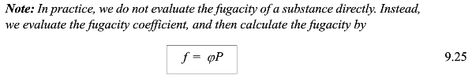

Slide 27
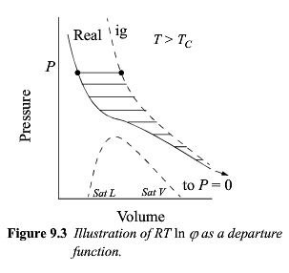
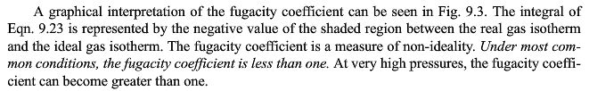

Slide 28
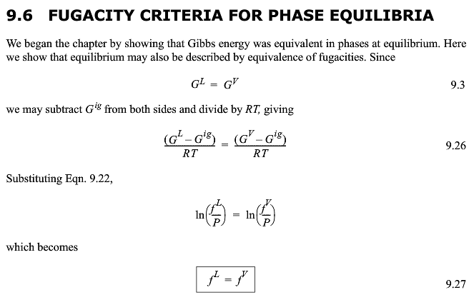
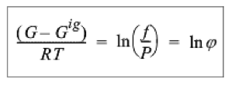

Slide 29

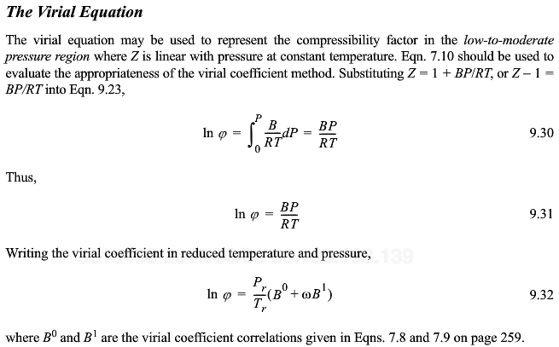

Slide 30
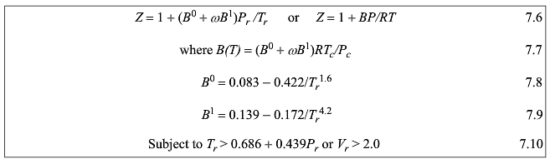

Slide 31
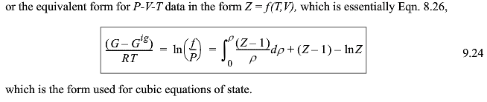



Slide 32
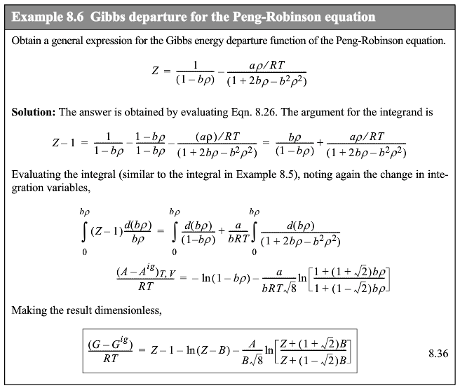


Slide 33

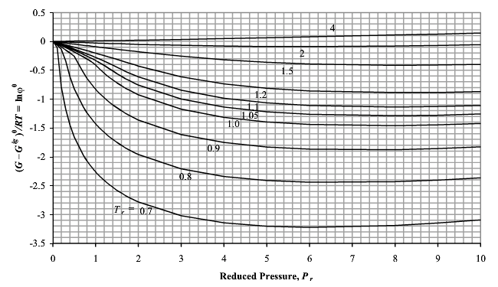
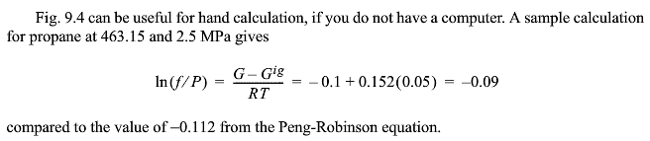
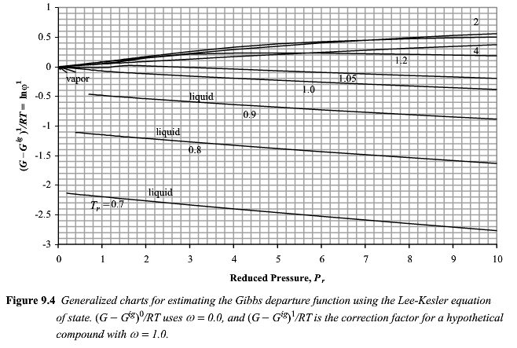

Slide 34
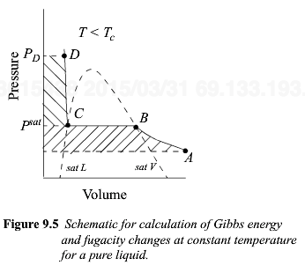

Slide 35

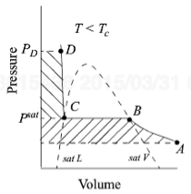

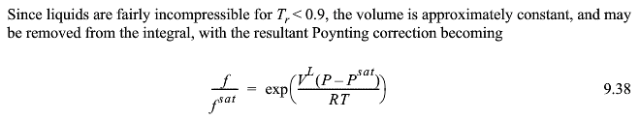


Slide 36
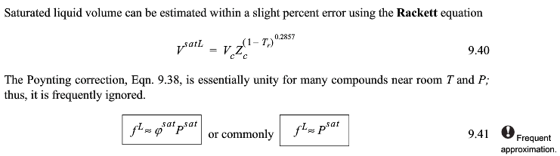


Slide 37




Slide 38
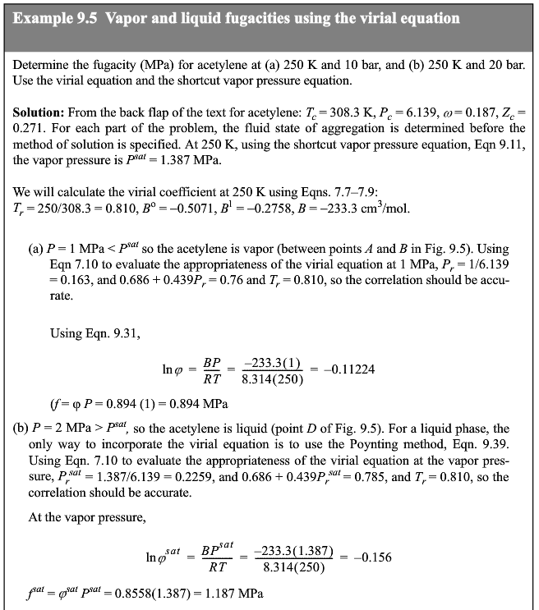
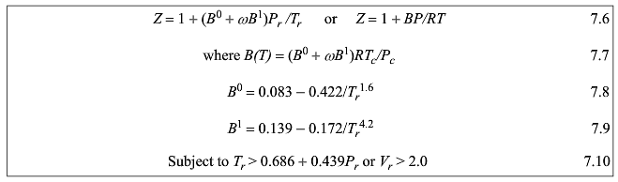
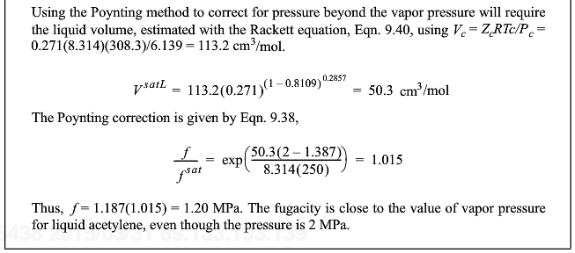



Slide 39
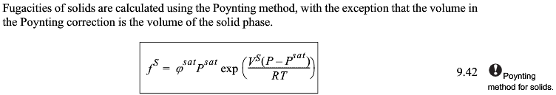


Slide 40

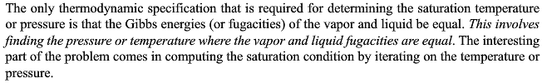

Slide 41
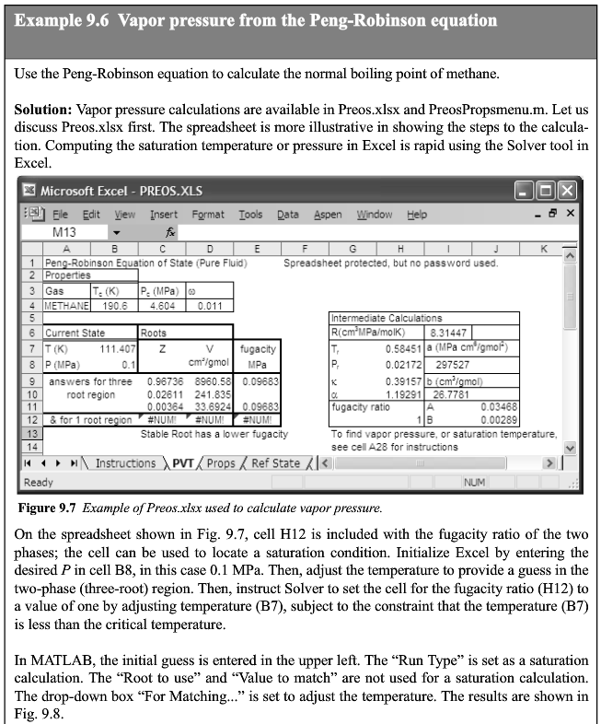
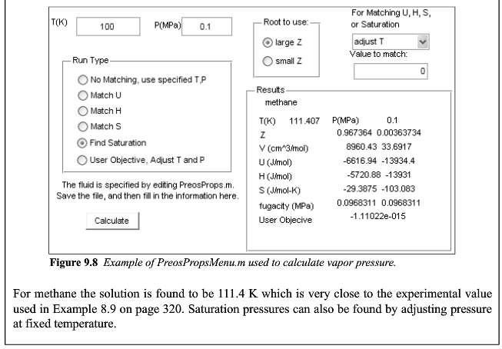

Slide 42
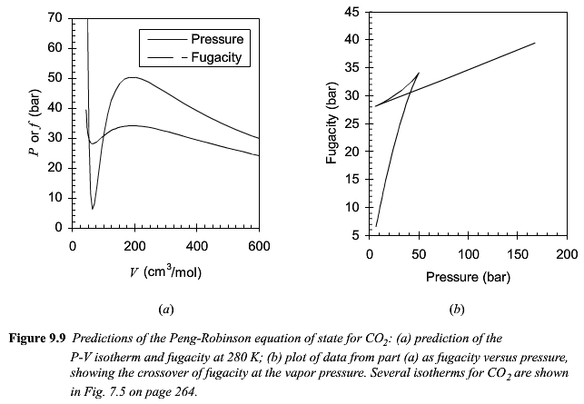

Slide 43
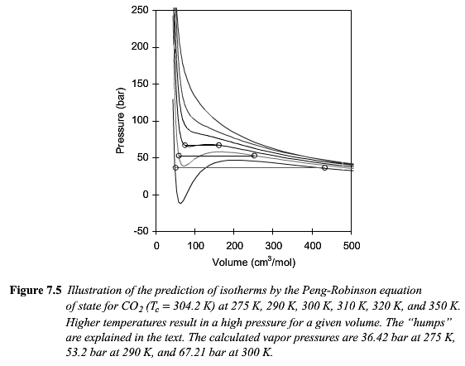

Slide 44
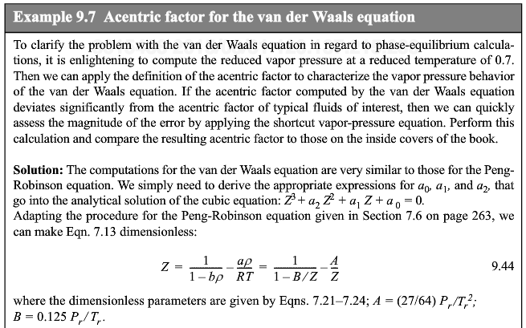


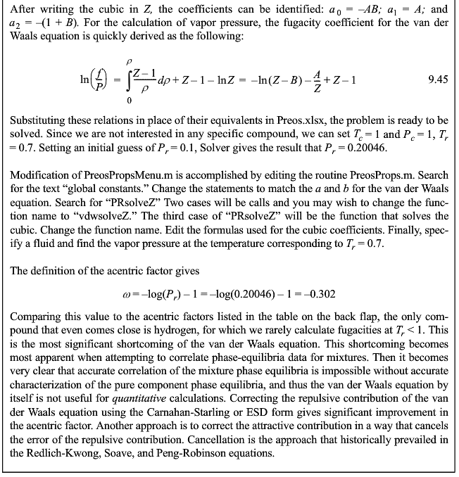




Slide 45




Slide 47


Slide 48

P₀ = (P_{max}+P_{min})/2

Slide 49



Slide 50


Slide 51



Slide 52


Slide 53


